Slide 1
CME: How to Track and Record Attendance

Slide 2
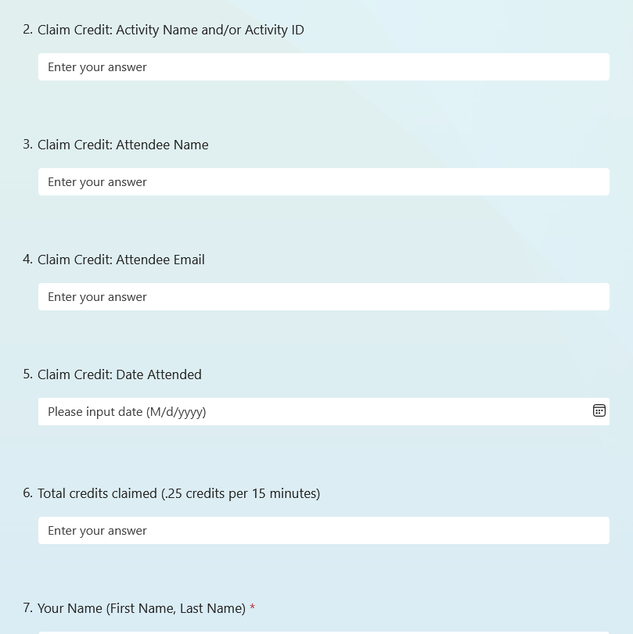
Submitting Attendance
Excel CME Attendance Sheet
First Name
Last Name
Email
Degree
Credit Date
Credit Amount
Microsoft Form
UW Faculty: Texting
CloudCME App (Org Code: UW)
Scan Attendance (QR Code)

Slide 3
TEXTING

Slide 4
Pairing Phone
① | Initial Set-Up – ONE TIME PROCESS
TEXT your EMAIL ADDRESS to 833-394-7078

Slide 5
Claiming Credit
② | Claim CME Credits – EVERY MEETING
TEXT the assigned code to 833-394-7078 Receive reply text: “Thank you [Your Name] we have recorded your attendance for [Today’s Activity]”. NOTE: If you do not receive a reply text, your CME transcript will not document today’s meeting participation. Credit must be recorded via text in the 60 minutes before, during, and up to 60 minutes after the activity concludes. If you miss the texting window, you must claim credits online at Microsoft Forms Link.

Slide 6
Mobile CloudCME App

Slide 7
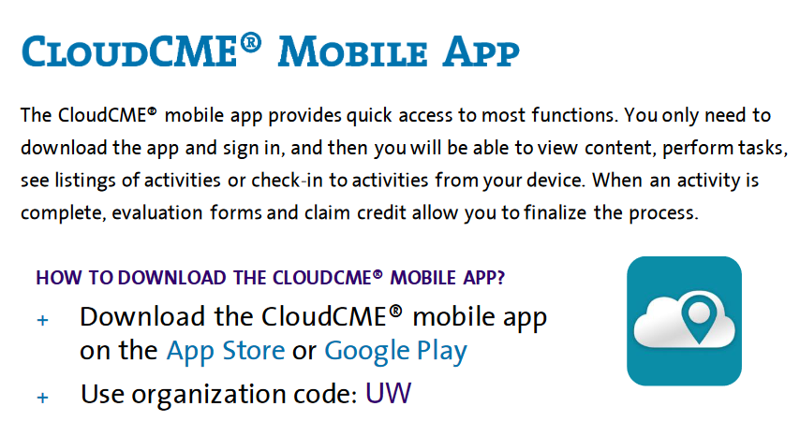
CloudCME App
QR Code would be provided by course coordinator to record attendance by using the CloudCME Mobile App.

Slide 8
Questions?

